Slide 1
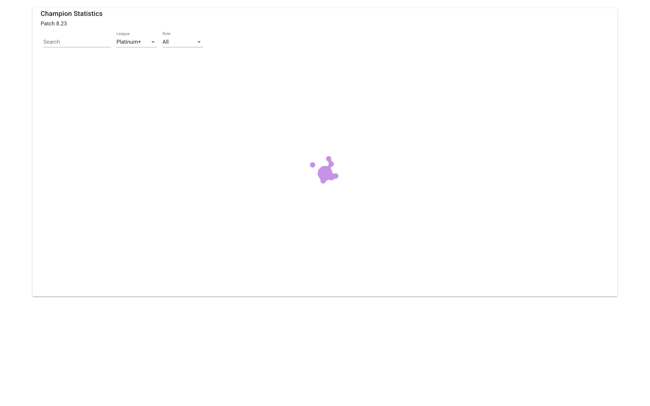
CS 242 Final Project
League of Legends Statistics Websites
Henry Woo
hcwoo2
Upon visiting the homepage, users are given an indication that data is being retrieved. Users can see the patch version of the data while the loading occurs.

Slide 2
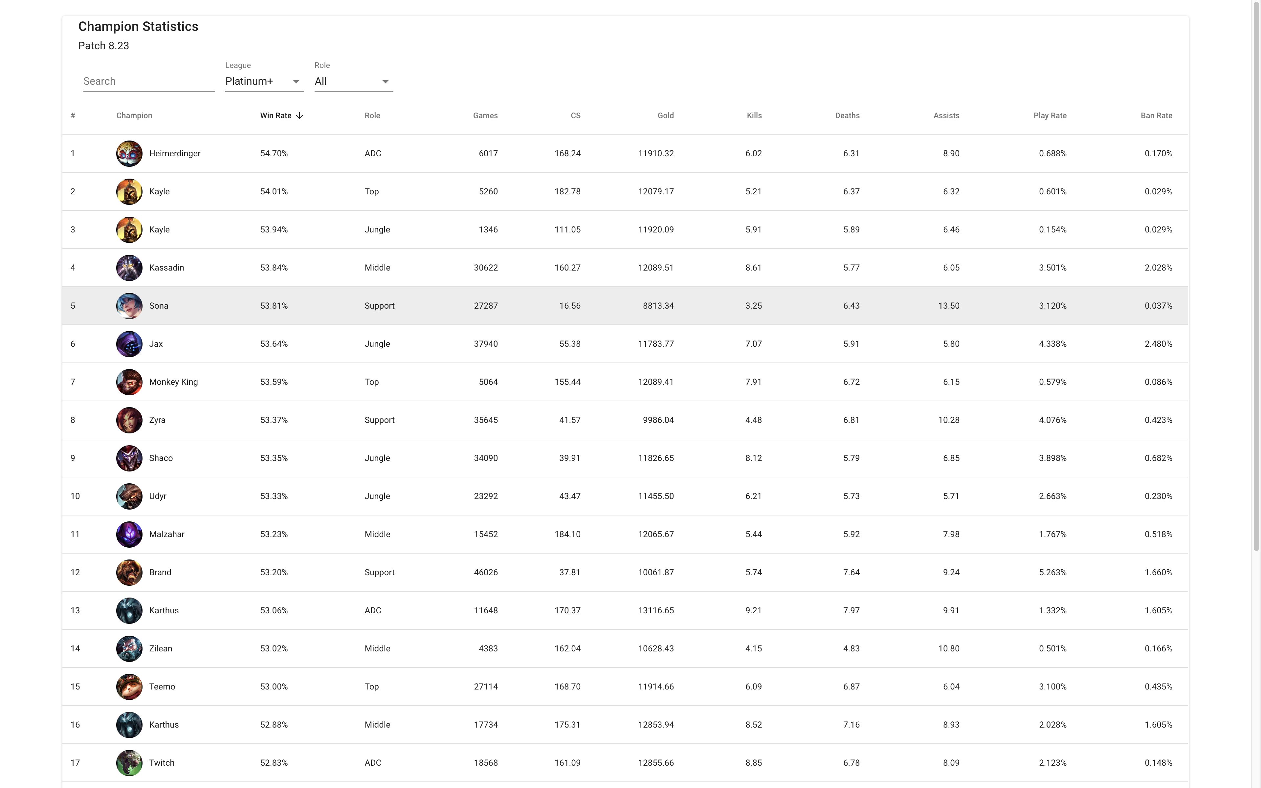
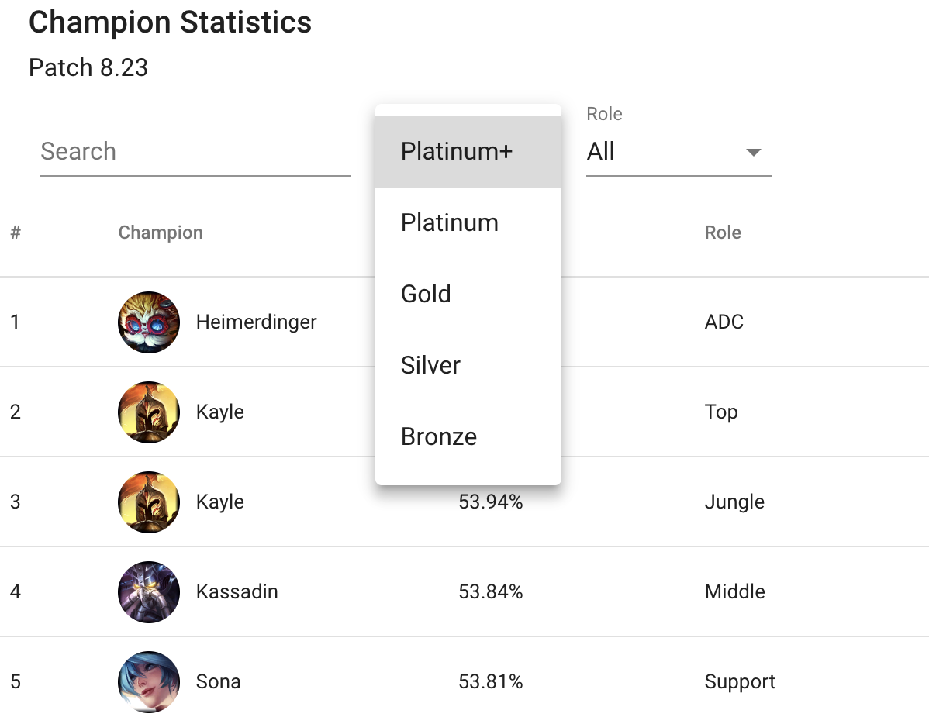
Once the data loads in, users can see various data about the characters they are interested in.
Users can filter the list to search for specific characters, change the league from which data is acquired, and filter by role.

Slide 3
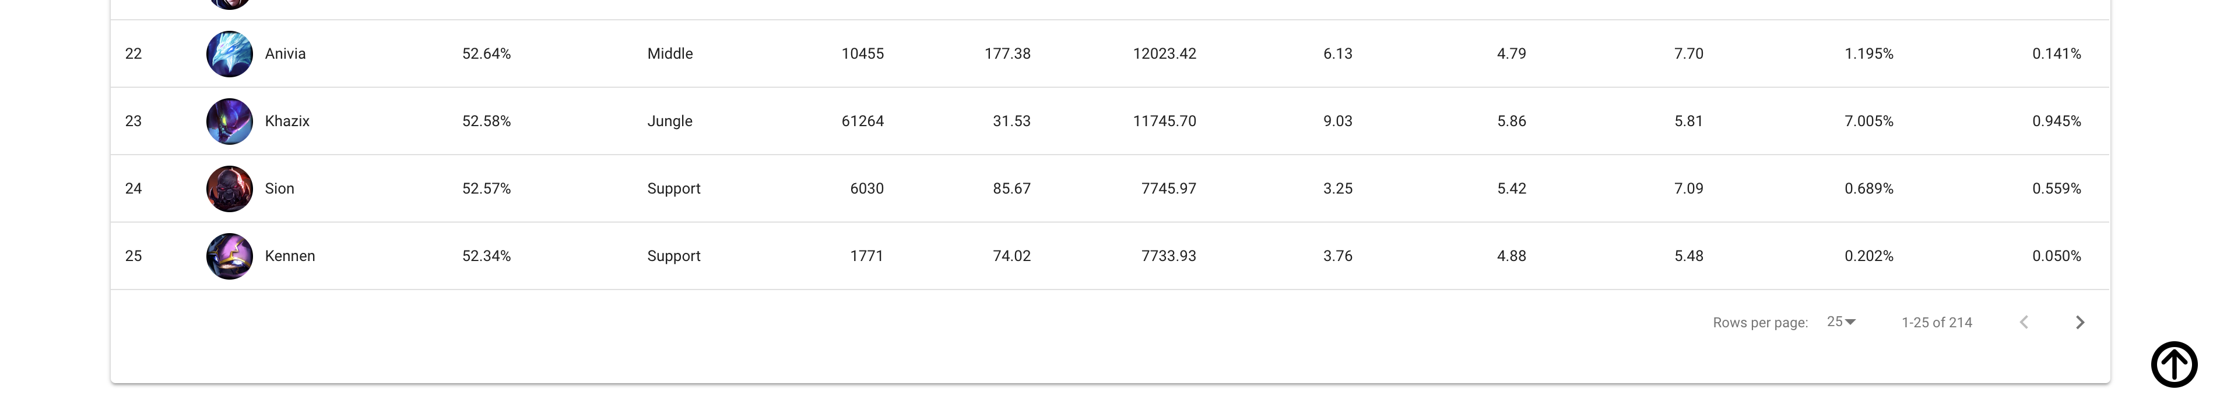
Once users reach the bottom of the page they may choose to define the amount of rows per page, go to the next page, and at any time scroll to the top using the arrow button at the far bottom-right corner.

Slide 4
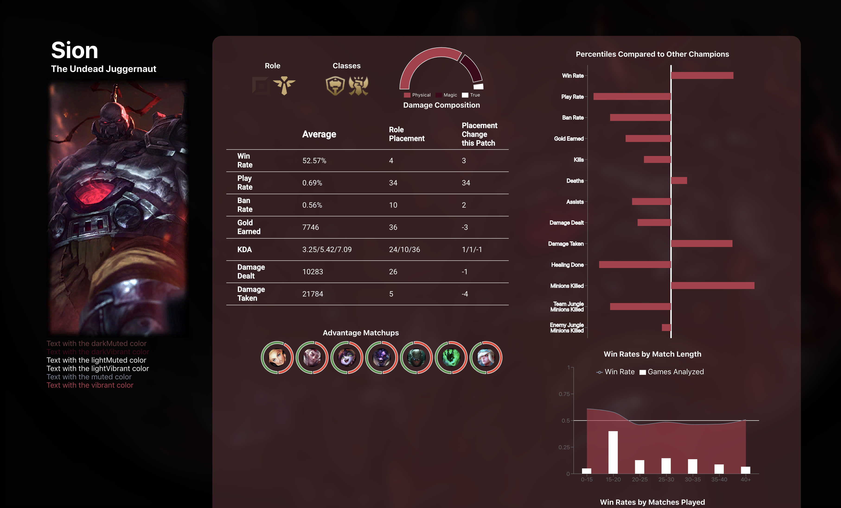
Clicking on the champion from the listings page will result in this page. Users can view statistics of their desired champion.

Slide 5
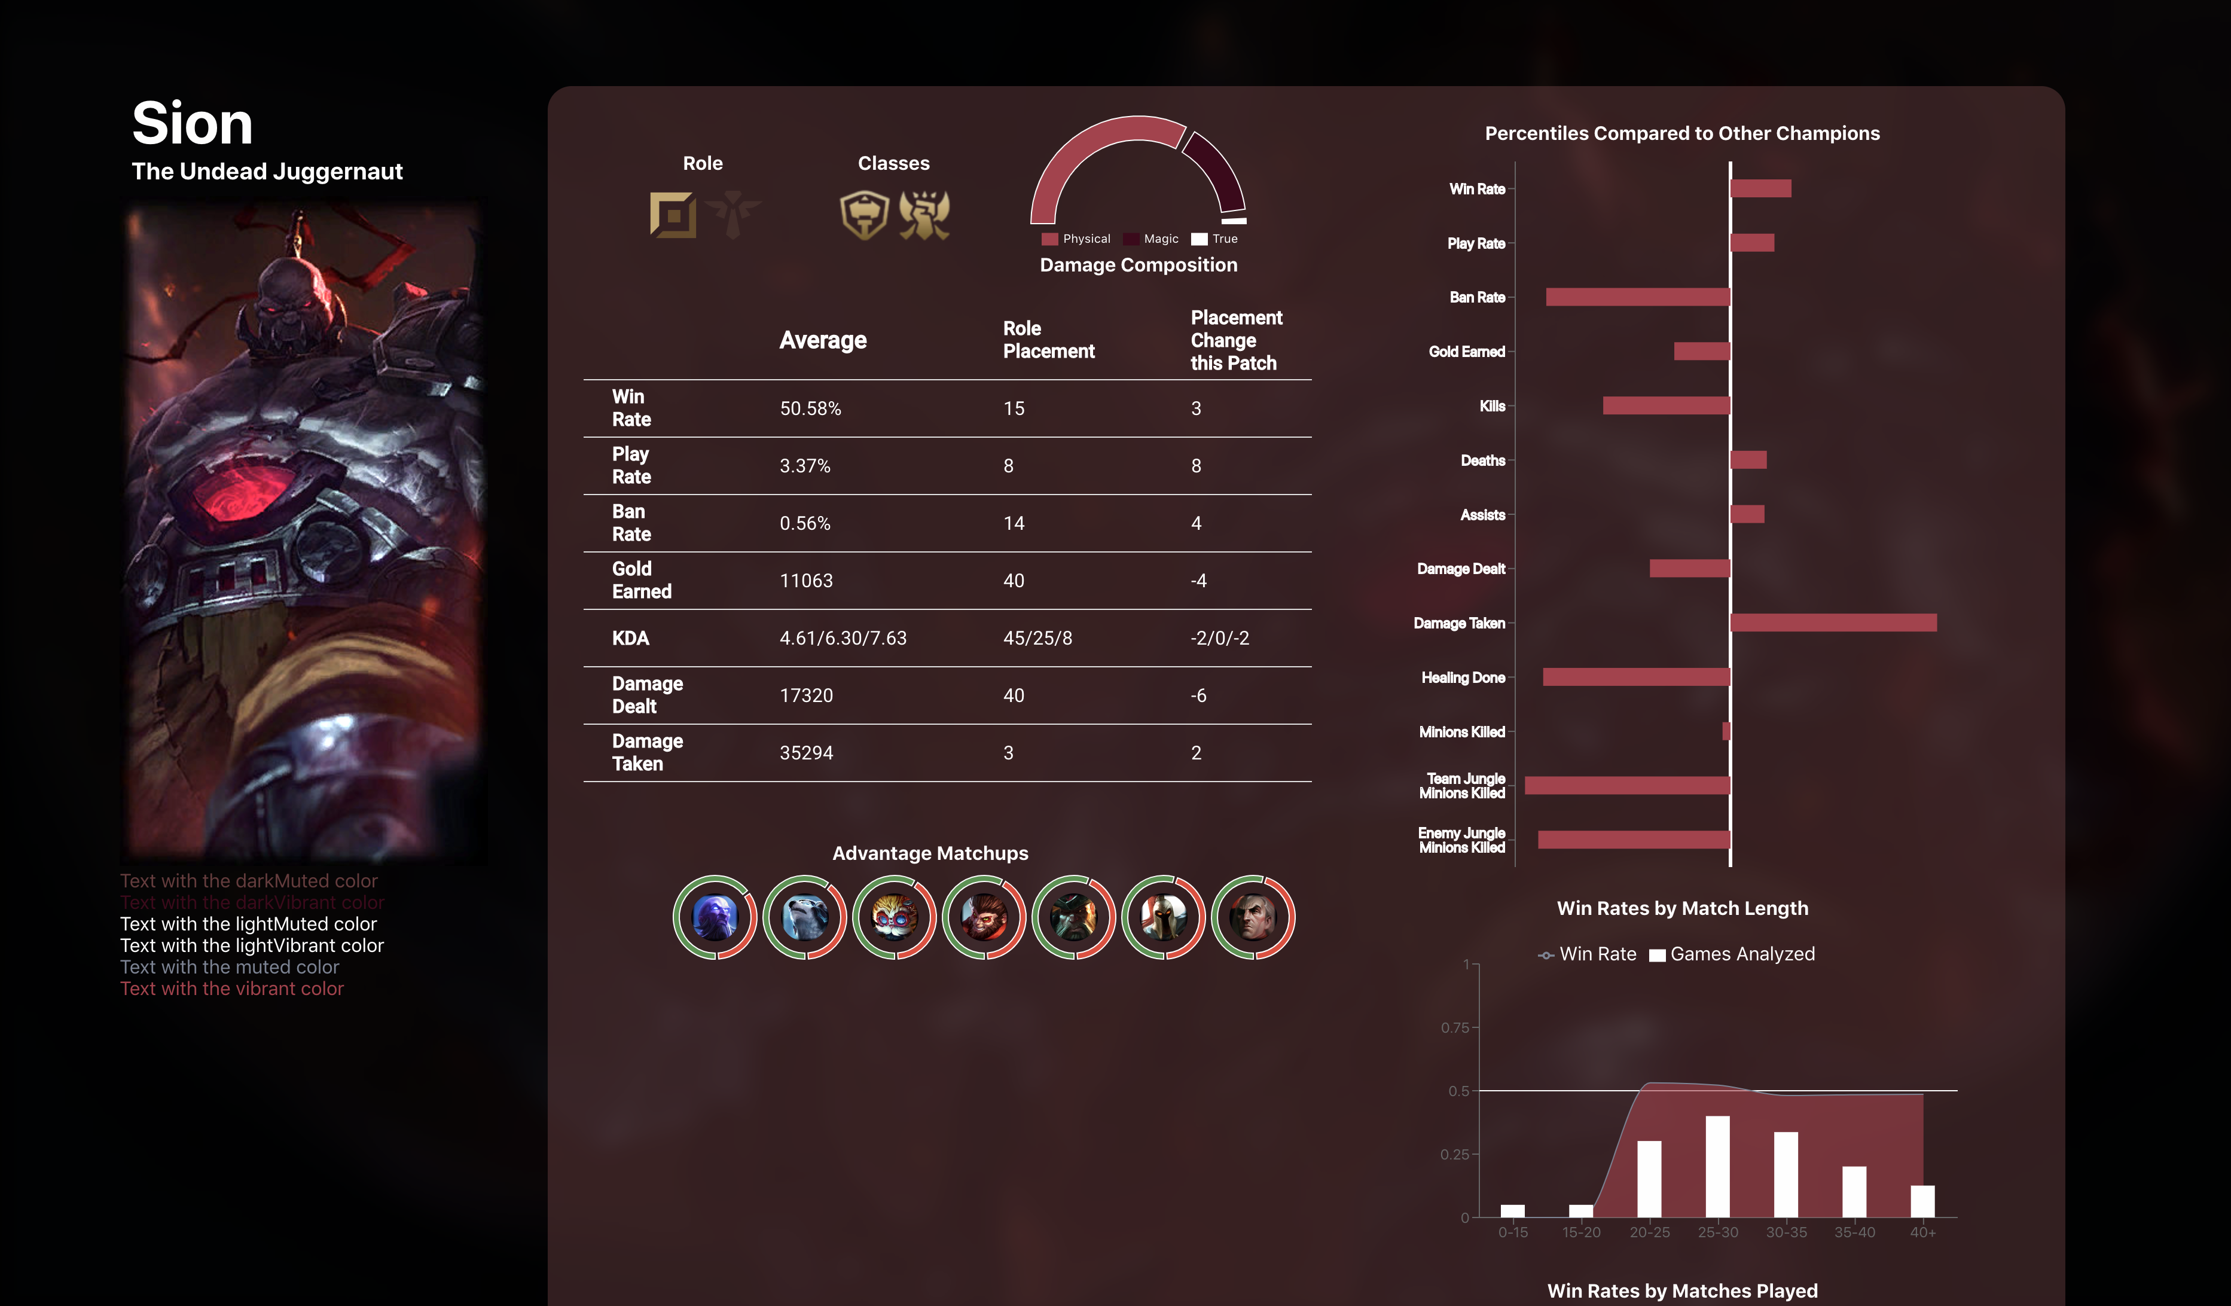
Clicking on a different role will re-render the page in a optimal manner such that the page does not need to refresh. The components are updated and the new page is still added to the browser history.

